Slide 1
Software Design & Development CFS2160
Week 9 – Intro to IntelliJ

Slide 2
Session Plan
An important message
Intro to IntelliJ
Work on todays worksheet.
Then work on any outstanding practical work.

Slide 3
An Important Message
Logbook Hand in.
The log book hand in date is the 19th of December at 17:00.
Please make every effort to make sure your Python work is complete this week.

Slide 4
Another Important Message
We Only Use Java Version 11!
If you create Java code in a version newer than V11 it may not work at uni!

Slide 5
New IntelliJ Project
You should a single project in IntelliJ, this should contain all practical work from each week.
You should open this single project each week and add new Java programmes to it.

Slide 6
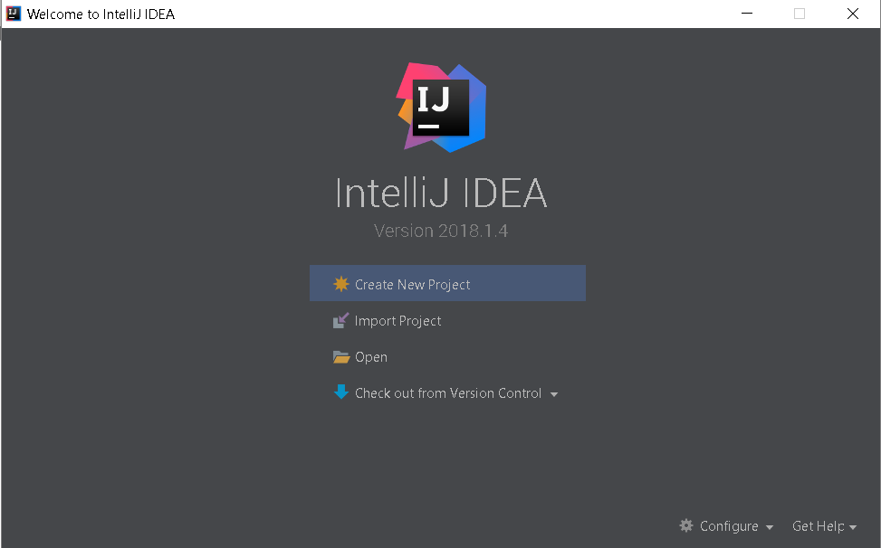
New IntelliJ Project
Open IntelliJ and click ‘Create New Project.

Slide 7
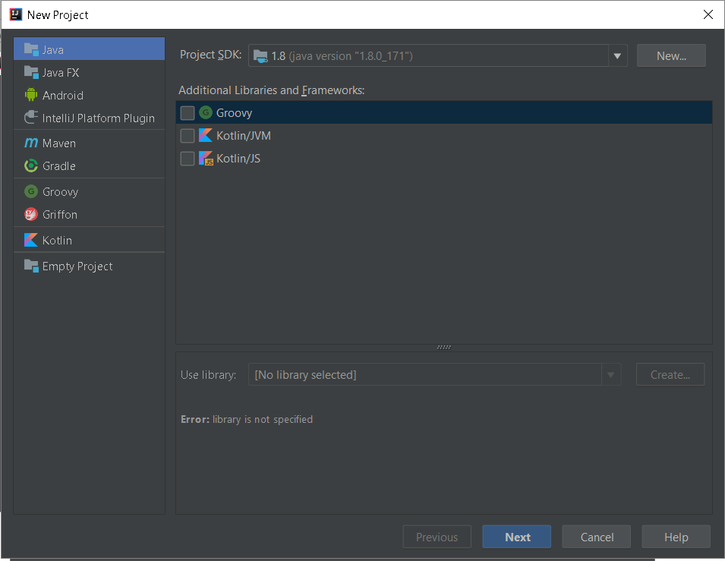
New IntelliJ Project
Select Java, ensure the Project SDK shows 1.11 for version 11.
Click Next

Slide 8
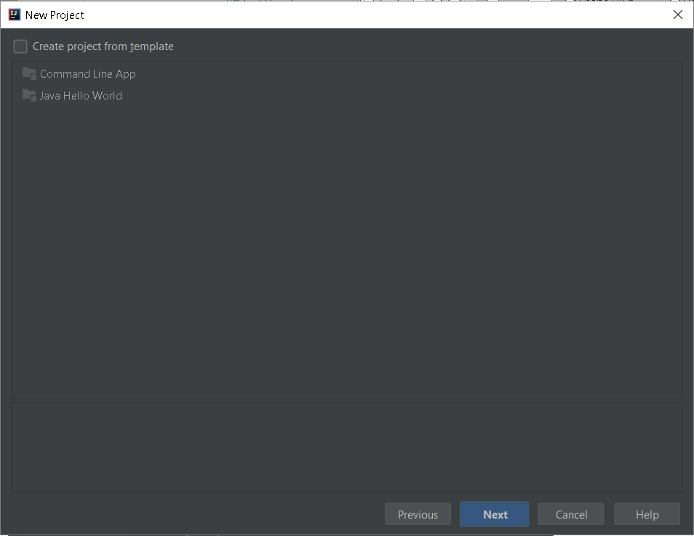
New IntelliJ Project
Click Next, we don’t need a template at this point

Slide 9
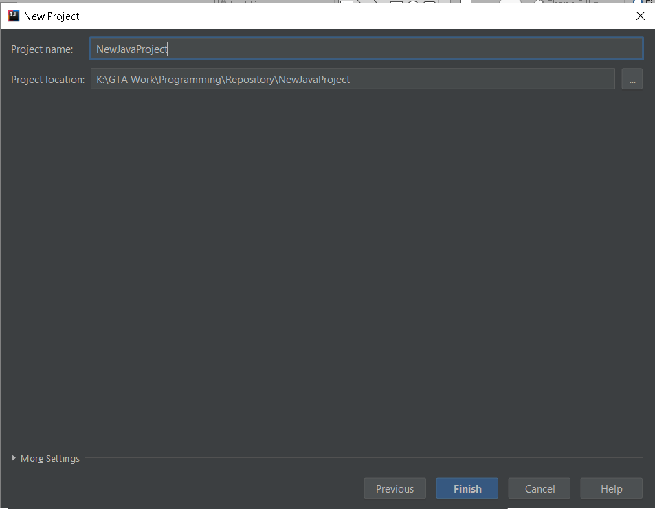
New IntelliJ Project
Enter the project name AND location.
These should be CamelCase for the name and the location should be somewhere on your K:/ drive!
Then click Finish

Slide 10
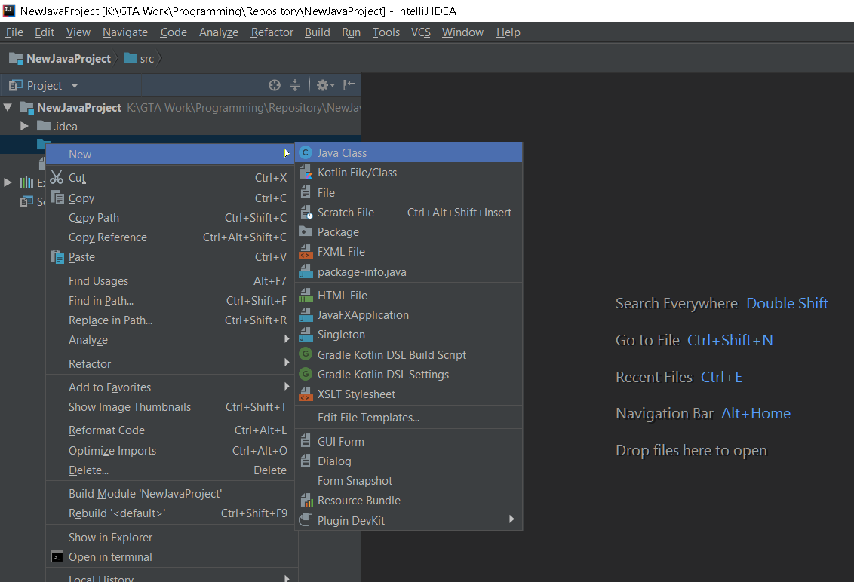
New IntelliJ Project
On the Src directory, right click ‘New / Java Class’
All Java code MUST be in the Src folder of your project.

Slide 11
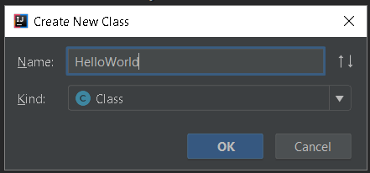
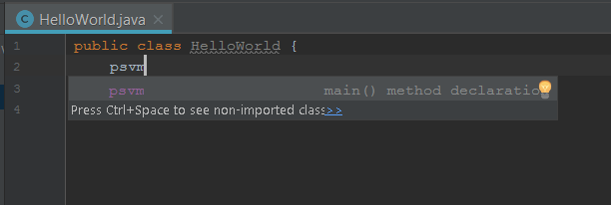
New IntelliJ Project
Type the name for the new Java Class in CamelCase, click OK
In the new Java file, psvm to add the Private Static Void Main method, IntelliJ will auto-suggest and complete the command, click enter to complete.

Slide 12
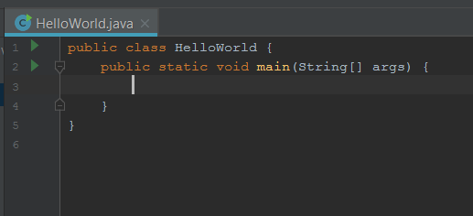
New IntelliJ Project
You now have a starting point for your Java class, enter the print statement as detailed in the lecture and required in the practical.
The code must go in the Main method body
To run the programme, click the Green Arrow to start.

Slide 13
Finally
From now on, your programming tutorials will be for java ONLY, if you have outstanding Python logbook work you should continue working on this in your own time. You can book 1 to 1 sessions with me for help, Tony is always available after the lecture, in his tutorials or via email for assistance and feedback.
I will able to help with both Python and Java in my study sessions for the next few weeks.
Complete the example in these slides to create a Java programme.
Any questions about Java?

